Slide 1
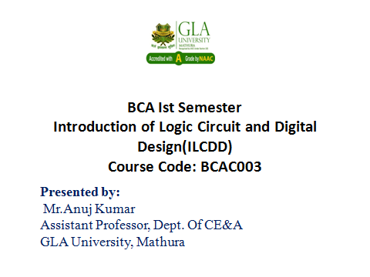

Slide 2
Register
Flip-flops are limited because they can store only one bit.
Two flip-flops are used for two-bit counters.
Most computers work with integers and single-precision floating-point numbers that are 32-bits long.
A register is an extension of a flip-flop that can store multiple bits.
N bit register can store n bit data.
Registers are commonly used as temporary storage in a processor.
They are faster and more convenient than main memory.
More registers can help speed up complex calculations.

Slide 3
Simple 4 bit register
Basic registers are easy to build. We can store multiple bits just by putting a bunch of flip-flops together!
A 4-bit register is shown on the right, and its internal implementation is below.
This register uses D flip-flops
it’s easy to store data without worrying about flip-flop input equations.
All the flip-flops share a common CLK and CLR signal.

Slide 4
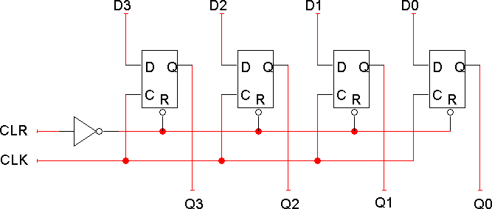

Slide 5
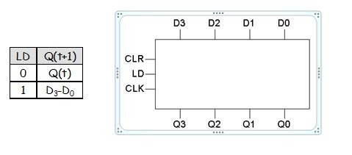
Adding a parallel load operation
The input D₃-D₀ is copied to the output Q₃-Q₀ on every clock cycle.
How can we store the current value for more than one cycle?
Let’s add a load input signal LD to the register.
If LD = 0, the register keeps its current contents.
If LD = 1, the register stores a new value, taken from inputs D₃-D₀.

Slide 6
Classification of Registers
Shift Register (bits are shifted from one flip flop to another)
(eg. Left or right shift Register)
Storage Register (bit are stored in flip flop and transferred to output)
(eg. Register with parallel load)
There are four mode of operations of a shift register.
Serial Input Serial Output
Serial Input Parallel Output
Parallel Input Serial Output
Parallel Input Parallel Output

Slide 7
